Slide 1
Psychopathology
Name
Institution
Date

Slide 2
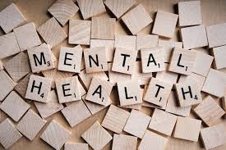
Psychopathology
Psychopathology refers to the study of mental illness such as behaviors and experiences caused by mental issues
Mental illness can be categorized into disorders, such as psychotic, cognitive, anxiety, developmental, personality, mood or substance
Psychopathology can result from alcohol and substance use, chronic conditions, biological reasons, isolation feelings and experiences such as stress or trauma
Psychopathology affects people socially, psychologically and emotionally (Hurst & Kavanagh, 2017).

Slide 3
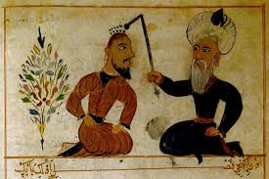
History of Mental Illness
Before the 15th century, mental illnesses were connected to religious beliefs and superpowers such as demons and evil spirits (Farreras, 2019)
Religious practitioners tortured people who were possessed as a way of treatment
Hippocrates rejected the idea of evil spirits and demons
He developed the idea that mental disorders resulted from disease infections in the brain
He believed that fluid imbalances in the body caused this disorder

Slide 4
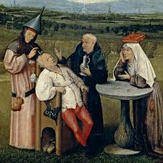
Continuation of History of Mental Illness
The present chemical imbalance used today was developed from this idea
According to Farreras. (2019), in the 17th century, the belief was based on the family environment
In the 18th century, the idea of a relationship between a parent and child was developed (Hurst & Kavanagh, 2017)
In the 19th century, clinical methods were introduced by Sigmund Freud (Farreras, 2019)

Slide 5
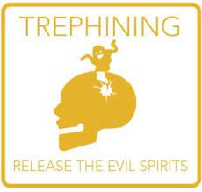
Treatment History
Trephination is among the oldest form of treatment used around 7000 years ago
It is believed that a saw or auger was used in treating mental disorders by removing part of the skull
In early 1600, bloodletting and purging were used in the western world (Farreras, 2019)
Imbalanced humor in the human body was believed to be the main cause of mental disorders by Claudius Galen
Other diseases such as diabetes, cancer and asthma were treated using bleeding and purging or vomiting (Druss & Goldman, 2018)

Slide 6
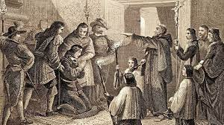
Continuation of Treatment History
In the 17th century, isolation and asylums were used to keep individuals with mental disorders away from families and the community (Farreras, 2019)
Restraining and ice water baths were commonly used for treatment
Between 1927 and the 1960s, insulin coma therapy was used (Druss & Goldman, 2018)
Physicians believed that insulin could interfere with brain functions
Patients were put in a low blood sugar coma

Slide 7

Continuation of Treatment History
Between the 1940s and 1950s, lobotomy was used till psychiatric medications were introduced (Druss & Goldman, 2018)
Connections between the frontal lobes and prefrontal cortex were surgically cut or removed
Metrazol therapy was introduced to induce seizures
According to Druss and Goldman. (2018), FDA withdrew seizure therapy from use in 1982 since it was dangerous
Research development in science led to modern mental treatments such as medicines and therapies

Slide 8
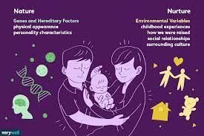
Influence of Nature Versus Nurture
Nature is contributed by biological factors such as genetic inheritance
Nurture is contributed by external factors such as life experiences (Galton, 2018)
In nature, individuals have a genetic inheritance from parents and may include hair color, height, skin color and eye color
Some diseases such as diabetes are inherited over generations

Slide 9
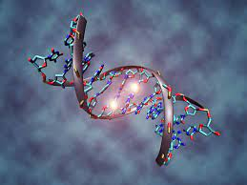
Continuation of Influence of Nature Versus Nurture
According to Bates et al. (2018), nurture involves the environment within which an individual grows after being born and may involve; exposure, real-life experiences and learning
An individual from a rich family has a greater advantage in getting an education than a low-income family
I believe nature influences mental illness because a genetic inheritance makes certain characters or conditions present over generations
I also believe nurturing affects mental illness because the environment people grow in or are exposed to shapes their thinking, actions and feelings

Slide 10
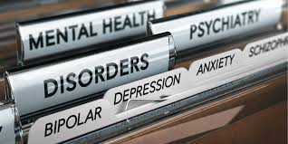
Conclusion
Psychopathology involves the study of mental disorders
The brain influences human thinking, acting and feeling
The process of mental illness treatment started before the 15th century (Druss & Goldman, 2018)
Since then, medicine development due to scientific research took place
Psychology may be influenced by both nature or nature

Slide 11
References
Bates, T. C., Maher, B. S., Medland, S. E., McAloney, K., Wright, M. J., Hansell, N. K., ... & Gillespie, N. A. (2018). The nature of nurture: using a virtual-parent design to test parenting effects on children's educational attainment in genotyped families. Twin Research and Human Genetics, 21(2), 73-83.
Druss, B. G., & Goldman, H. H. (2018). Integrating health and mental health services: a past and future history. American Journal of Psychiatry, 175(12), 1199-1204.
Farreras, I. G. (2019). History of mental illness. General psychology: required reading.
Galton, F. (2018). English men of science: Their nature and nurture. Routledge.
Hurst, J. E., & Kavanagh, P. S. (2017). Life history strategies and psychopathology: The faster the life strategies, the more symptoms of psychopathology. Evolution and Human Behavior, 38(1), 1-8.

